Slide 1
E-SPORTS AND GAMING ANALYSIS

Slide 2
Online Gaming in Africa
Africa is the second largest continent of the World and it’s believed to be the cradle of human kind, hence, a good start where researches can be drawn and insights deduced.
Playing video games over the internet, alone or with others, typically in real time makes up online gaming and the importance of games cannot be overly emphasized as it fosters communities, creativity, entertainment, and skill development.
One Gap Nukleus is a technological firm looking to incorporate online games into a platform where individuals can access video gaming on the go! All winnings will be rewarded with a token called ‘Nukleus’.

Slide 3
Data Overview
Our Dataset carries information as ‘different video games, the platforms used for these games, genre, year of release, the publishers, different sales and ratings.
We chose this dataset for its content and the fact that we can deduce insights about games published in different year with the platforms used by individuals to access these games and the sales made to ascertain gains or losses thus, streamlining business decisions.

Slide 4
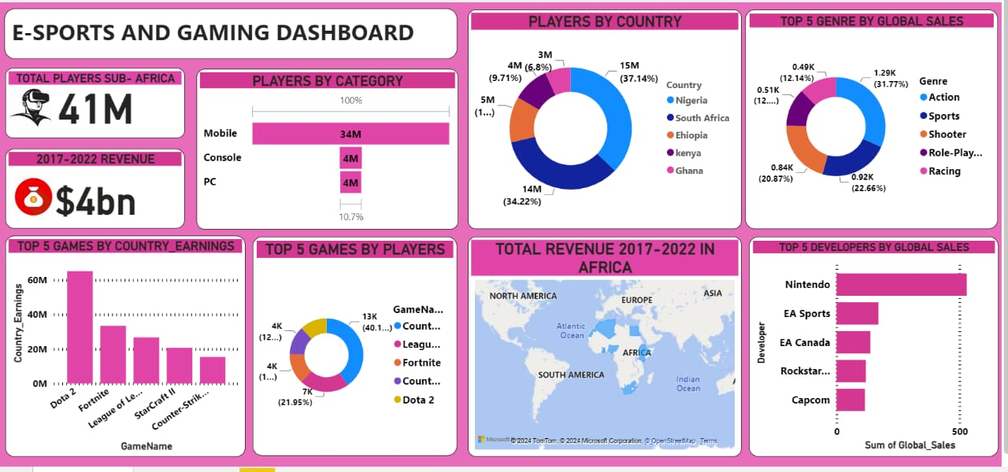
VISUALIZATION DASHBOARD

Slide 5
PROJECT INSIGHT
Nigeria has the highest players and thus can be categorized as the highest playing country in Sub-Saharan Africa. With this, we can say that gaming in Nigeria is a great tool for entertainment and an untapped revenue generation sector.
Action-Genre categorized the top game globally following the sales generated. This shows that individuals tend to develop interest for action activities.
From 2017-2022, Revenue generated from video online games in Africa amounted to $4billion, with a further prediction of $1billion for 2024 alone. It shows that E-sports and video gaming is a profitable/viable venture.
Nintendo topped the chart for Developer by sales globally. This could be attributed to the type/genre of games published which shows a correlation to the interest of individuals opting for these games.
There were 3 major categories used for online gaming. Mobile topped the chart which indicates that individuals preferred the use of their mobile devices for online games, as this is readily available and affordable compared to other categories.
Games with Multiplayer ability have more players compared to games with single player.

Slide 6
PROJECT RECOMMENDATIONS
Improve and Streamline the process for online games. Following the insights, the use of mobiles surpasses other categories been used, thus, streamlining the process for individuals to access games through mobiles will be imperative for retention.
Player Engagement Metrix. Monitor the daily and monthly active users to gauge overall player engagement levels.
Less advert and bugs in games will encourage players to play.
Education and Skill Development. Introduce E-sports and gaming programs in educational institutions to cultivate talent and offer professional development and provide training and mentorship programs for aspiring E-sports players, managers etc.
Forge partnerships between government agencies, private entities to drive investment and support for the industry by brining global expertise and resources to Africa E-sports Ecosystem.
Nigeria with its large youthful population and smart phone users should be a target market and incorporate females to gaming.

Slide 7
CONCLUSION
In conclusion, by implementing these recommendations, Africa can create a vibrant and sustainable ecosystem for E-sports and video gaming, nurturing talents, fostering a sense of community, and contributing to the global E-sports Landscape.

Slide 8

THANK YOU
DANKE SCHON

